Slide 1
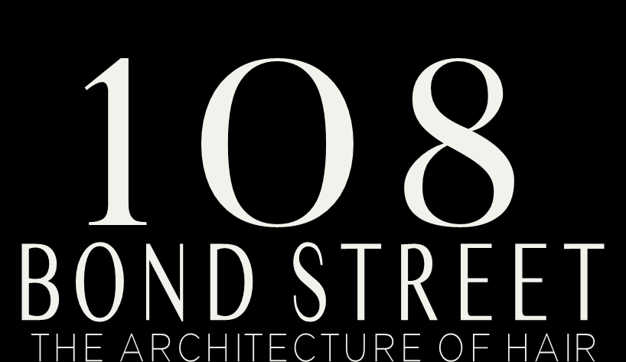
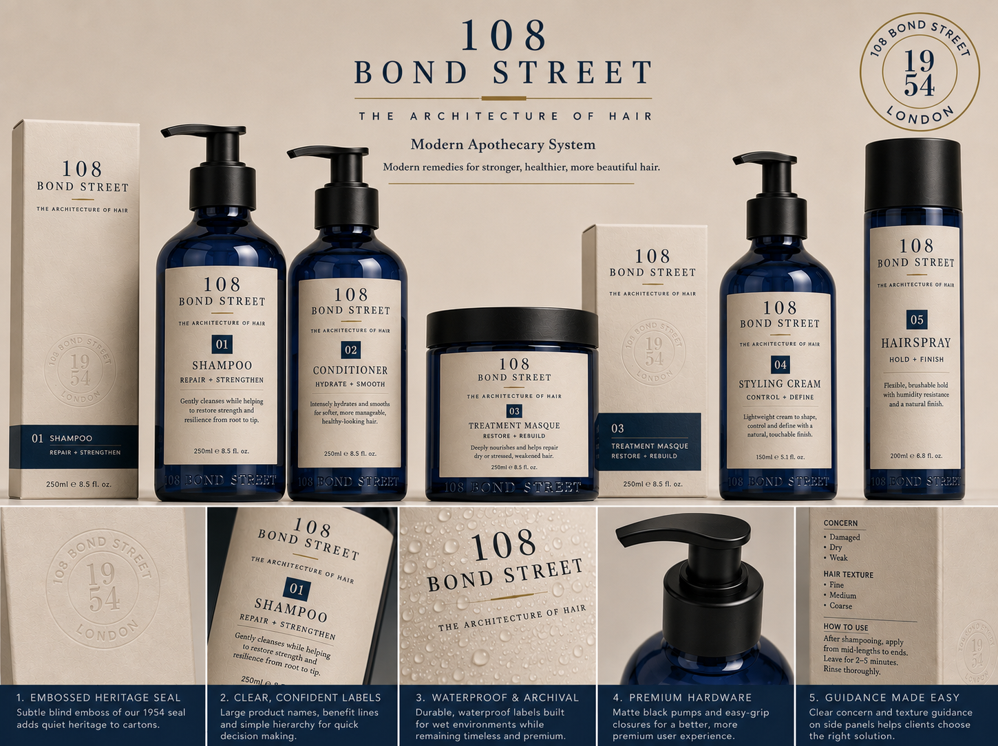
Investor Presentation
2026
Confidential — Not a Securities Offering

Slide 2
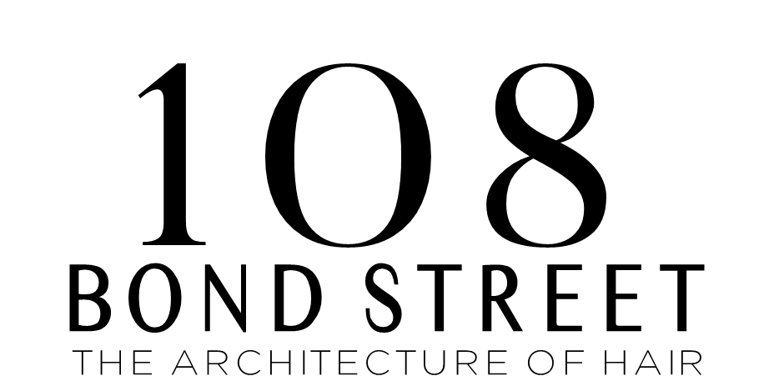
The Investor Thesis
A prestige hair care brand with a clear reason to exist.
108 Bond Street is not another “repair” brand. It is a structure-first hair care house built on an ownable idea, an authentic heritage address, and a premium visual system.
01
OWNABLE IDEA
02
LEGITIMATE HERITAGE
Architecture gives the brand a category language competitors do not own.
108 Bond Street, London, 1954 connects the product to the birth of modern hair design.
03
PREMIUM PACKAGE SYSTEM
04
CONTROLLED DISTRIBUTION
Anodized aluminum, cream labels, silver accents, no excess carton waste.
Salon-first education creates authority before wider retail expansion.
108 BOND ENTERPRISES, LLC · CONFIDENTIAL · INVESTOR PRESENTATION 2026
THE ARCHITECTURE OF HAIR

Slide 3
The Problem
The prestige hair care market is loud, crowded, and increasingly difficult to trust.
01
02
03
Too Much Noise
No Clear Territory
Trust Gap
Influencer claims, celebrity extensions, and miracle language have trained premium consumers to question what brands say.
Most brands compete around ingredients, molecules, bonds, peptides, or salon celebrity — not around structure and architectural precision.
Discerning consumers still want performance, but they want it translated honestly and visually signaled with restraint.
Opportunity: claim the premium territory between technical performance and architectural design.
108 BOND ENTERPRISES, LLC · CONFIDENTIAL · INVESTOR PRESENTATION 2026
THE ARCHITECTURE OF HAIR

Slide 4
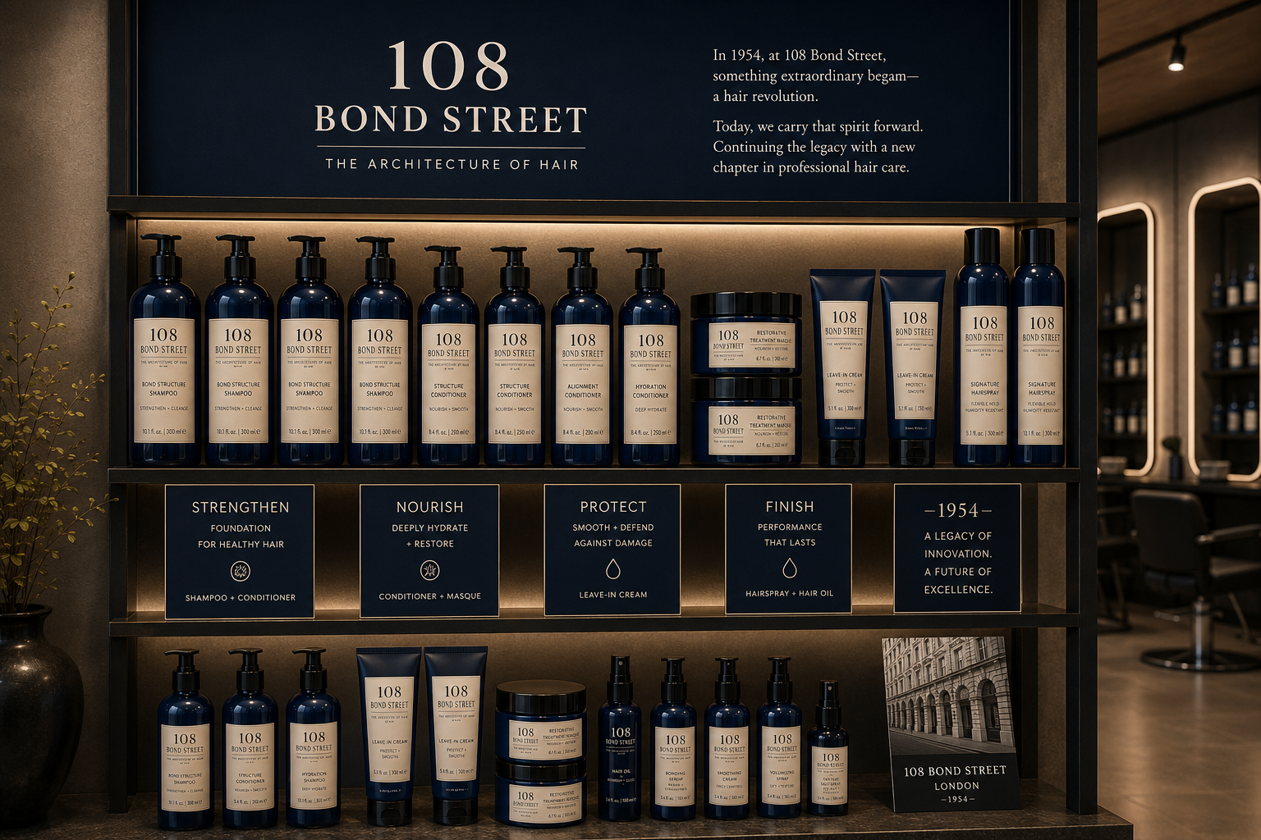
The Solution
The Architecture of Hair turns heritage, formula, education, and packaging into one system.
01
Structure-first language
Alignment, balance, depth, condition, and integrity — a framework consumers can understand.
02
Disciplined claims
No pseudo-science. No exaggerated miracle promises. Performance communicated with restraint.
03
Education as distribution
Stylists become the living proof of the Architecture of Hair, not just a sales channel.
04
Ethical baseline
Vegan, cruelty-free, sustainably minded packaging choices and no unit carton waste.
108 BOND ENTERPRISES, LLC · CONFIDENTIAL · INVESTOR PRESENTATION 2026
THE ARCHITECTURE OF HAIR

Slide 5

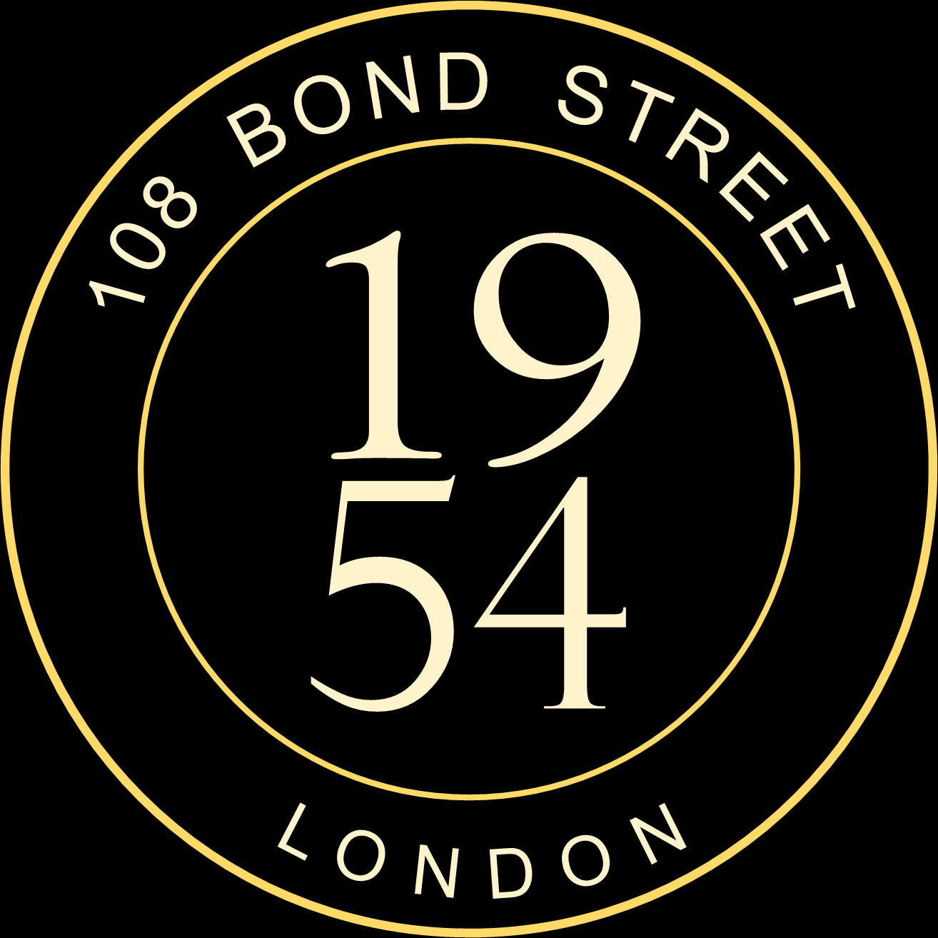
1954: The Address Becomes the Brand
108 Bond Street gives the brand a real origin story — not a manufactured one.
1954
Modern Design
Legacy
Vidal Sassoon opens the Bond Street salon.
Geometric precision changes how hair is cut, worn, and understood.
Architectural hair becomes a language of discipline, shape, and confidence.
Eden and Elan carry the legacy forward as a modern product house.
The brand is positioned as a living continuation — modern, commercial, and future-facing.
108 BOND ENTERPRISES, LLC · CONFIDENTIAL · INVESTOR PRESENTATION 2026
THE ARCHITECTURE OF HAIR

Slide 6
Founders
A family legacy with equal ownership and a shared standard.
Eden Sassoon
Elan Sassoon
CO-FOUNDER & CHIEF CREATIVE OFFICER
CO-FOUNDER & CHIEF EXECUTIVE
Daughter of Vidal Sassoon. Known for luxury salon environments, professional standards, and a modern creative lens on hair culture.
Son of Vidal Sassoon. Global hair authority, educator, and entrepreneur carrying a 70-year architectural hair legacy forward.
50% MEMBERSHIP EQUITY
50% MEMBERSHIP EQUITY
Each founder holds 50% membership equity, diluted equally upon third-party investment.
108 BOND ENTERPRISES, LLC · CONFIDENTIAL · INVESTOR PRESENTATION 2026
THE ARCHITECTURE OF HAIR

Slide 7
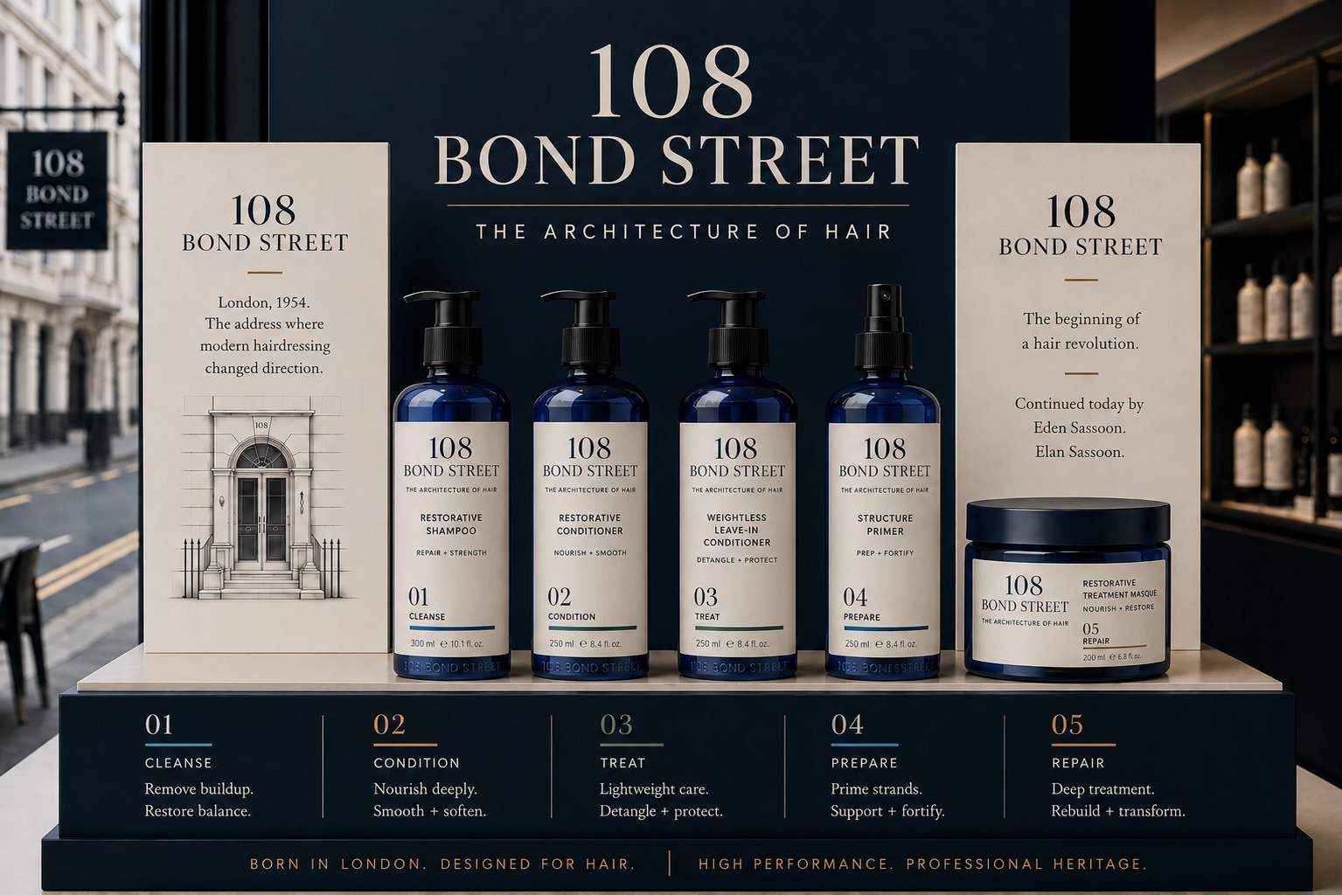
Built to Be Owned
Every brand element reinforces one singular idea: The Architecture of Hair.
01
Tagline
02
Visual System
The Architecture of Hair
Deep navy, cream label, brushed silver, precise type spacing
03
Voice
04
Foundation
Confident, minimal, technical — but never clinical
Vegan, cruelty-free, sustainably minded
05
IP
06
Education
Trademark filings for core brand territory
Training turns the idea into a professional movement
108 BOND ENTERPRISES, LLC · CONFIDENTIAL · INVESTOR PRESENTATION 2026
THE ARCHITECTURE OF HAIR

Slide 8
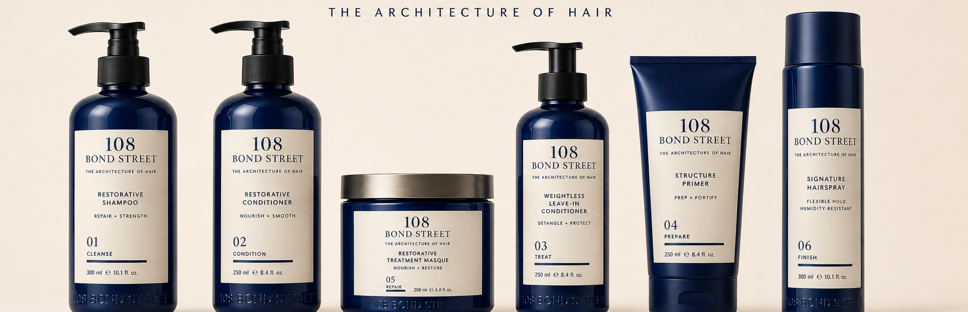
Product Portfolio
Five core SKUs plus one Founder Circle limited edition.
SHAMPOO
CONDITIONER
TREATMENT
BONDING
HYDRATION
FOUNDER CIRCLE LE
35%
65%
CA
COGS Target
Gross Margin Target
Contract Manufacturing
108 BOND ENTERPRISES, LLC · CONFIDENTIAL · INVESTOR PRESENTATION 2026
THE ARCHITECTURE OF HAIR

Slide 9
The 108 Bond Street Consumer
Premium, salon-aware, values-led, and allergic to hype.
WHO THEY ARE
WHAT THEY DEMAND
— Salon-educated and stylist-influenced
— Structural results, not marketing promises
— Ethically conscious: vegan, cruelty-free, sustainable
— Verifiable performance language
— Discerning and inquisitive
— Legitimate heritage and credibility
— Early adopter of premium quality
— Premium packaging with intelligence and restraint
— Shops Sephora, Ulta, and prestige specialty retail
— An elevated sensory experience
This consumer pays premium prices when the brand feels intelligent, credible, and visibly different.
108 BOND ENTERPRISES, LLC · CONFIDENTIAL · INVESTOR PRESENTATION 2026
THE ARCHITECTURE OF HAIR

Slide 10
Competitive Position
108 Bond enters the one conceptual territory the category has not claimed.
CURRENT FIELD
108 BOND STREET ADVANTAGE
Conglomerates
Architectural framework
Heritage credibility
Scale and resources, but often diluted prestige and brand stretch.
Structure, geometry, precision.
108 Bond Street, London, 1954.
Salon legacy players
VS
Controlled distribution
Disciplined claims
Professional authority, but many have expanded broadly and lost sharpness.
No Amazon until brand equity is established.
Trust over exaggeration.
Prestige disruptors
Founder nucleus
Early investors become brand architects.
Built heat quickly, then risked commoditization through broad platform exposure.
108 BOND ENTERPRISES, LLC · CONFIDENTIAL · INVESTOR PRESENTATION 2026
THE ARCHITECTURE OF HAIR

Slide 11
A Category Ready to Be Disrupted
108 Bond Street enters the one conceptual territory no competitor has claimed.
THE COMPETITION
108 BOND STREET ADVANTAGE
L'Oréal / P&G / Henkel / Estée Lauder
Ownable Architectural Framework
Heritage Credibility
Multi-billion conglomerate portfolios. Scale is high, but prestige clarity can dilute across broad product and haircolor revenue bases.
Competitors speak molecules. 108 Bond treet speaks structure, geometry, and precision.
108 Bond Street, London, 1954 — an origin story no competitor can manufacture.
John Paul Mitchell Systems
Major private player with professional authority, but category sharpness has waned as distribution and pricing expanded broadly.
Controlled Distribution
Disciplined Claims Strategy
VS
Prestige protected through disciplined channel sequencing and no early Amazon exposure.
No exaggeration. No pseudo-science. Verifiable, translatable performance language.
Olaplex / K18 / Oribe / OUAI
Independent disruptors built heat quickly, then became exposed to platform commoditization and substitution.
Founder-Driven Cultural Nucleus
Exit-Ready Brand Architecture
Amazon
Founder Circle creates early ambassadors and a brand-architect community.
Designed for acquisition by a strategic buyer at an estimated 2–5× net sales range.
Explicit strategic risk. 108 Bond avoids Amazon until Year 5, after brand equity and consumer demand are established.
Investor takeaway: the category is crowded, but the architectural territory is open — and 108 Bond Street is built to own it before the market can copy it.
108 BOND ENTERPRISES, LLC · CONFIDENTIAL · INVESTOR PRESENTATION 2026
THE ARCHITECTURE OF HAIR

Slide 12
Controlled Launch. Disciplined Growth.
Market entry emphasizes limited availability, authority, and early-adopter privilege.
Pre-Launch
Year 1
Years 2–3
Years 4–5
01
02
03
04
Founder Circle
Salon + DTC
Prestige Retail
International + Wholesale
Investor base becomes cultural nucleus. Limited edition product builds aura before first retail sale.
Professional channel first. Education and stylist endorsement generate pull.
Sephora, Ulta, and selected specialty retail. U.S./Canada first.
EU, Australia, South Africa. Amazon only after equity is established.
108 BOND ENTERPRISES, LLC · CONFIDENTIAL · INVESTOR PRESENTATION 2026
THE ARCHITECTURE OF HAIR

Slide 13
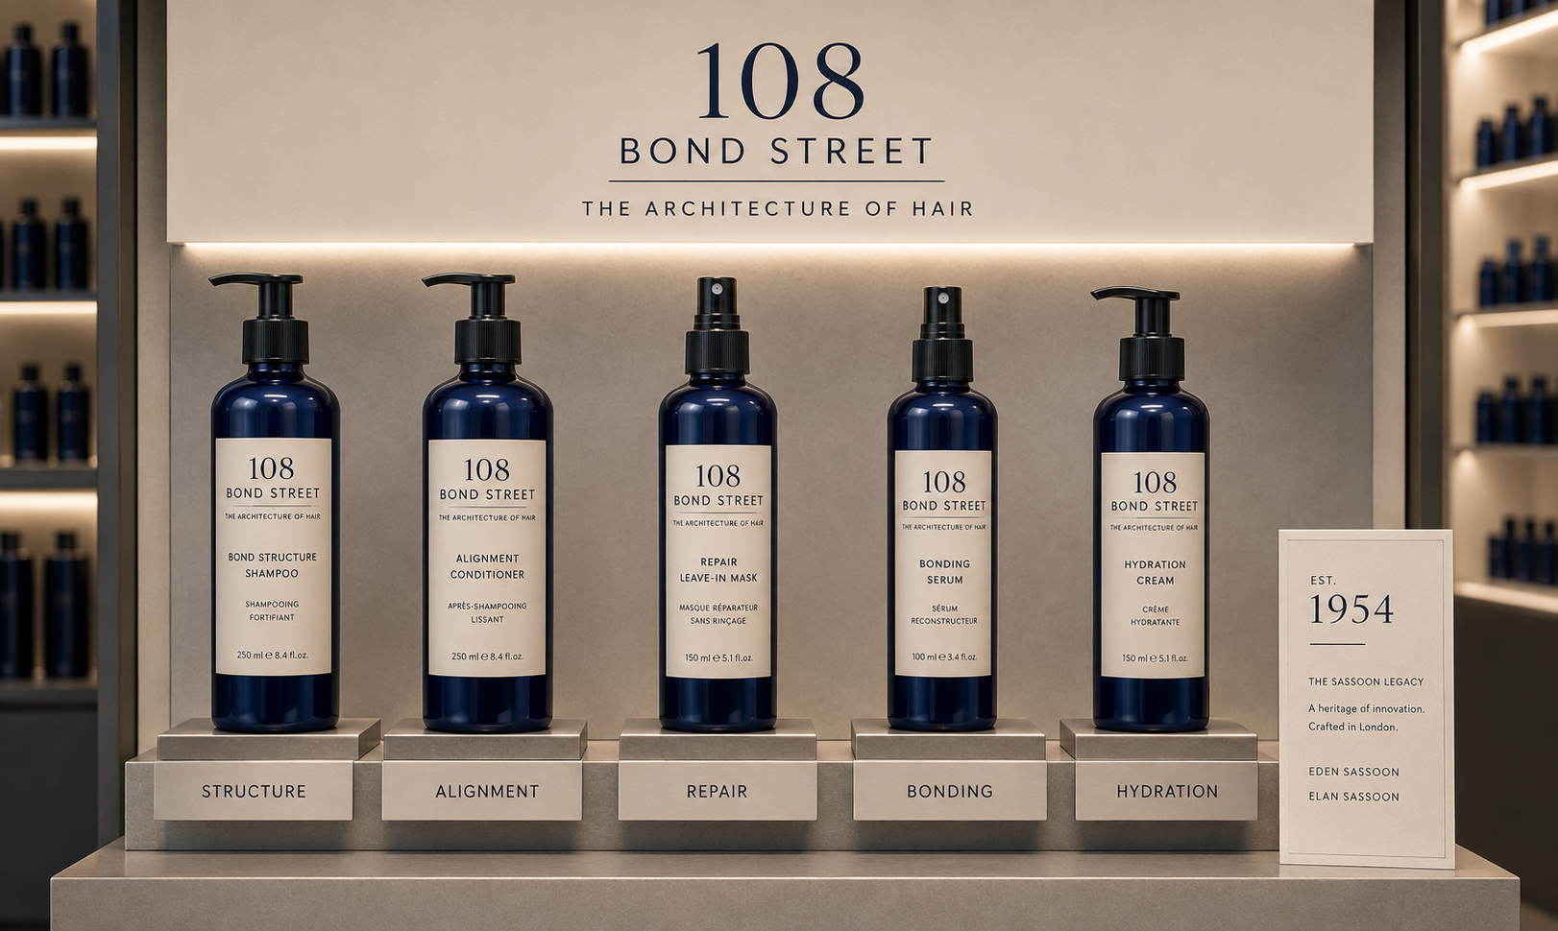
What It Looks Like at Retail
The product system already reads as premium, architectural, and shelf-ready.
Modern apothecary. Cream label. Deep navy aluminum. Silver hardware. Clear product hierarchy.
108 BOND ENTERPRISES, LLC · CONFIDENTIAL · INVESTOR PRESENTATION 2026
THE ARCHITECTURE OF HAIR

Slide 14
7-Year Net Sales Trajectory
U.S. launch in Year 1 scaling to full omni-channel global distribution by Year 7.
$63.4M
$63.4M
$52.8M
Year 7 Net Sales Target
$44M
$29M
$12.7M
Year 7 Operating Income at 20% Margin
$20M
$12M
$7.5M
2–5×
Implied Exit Multiple Range
YR 1
YR 2
YR 3
YR 4
YR 5
YR 6
YR 7
2027
2028
2029
2030
2031
2032
2033
Forward-looking projections are management targets and are not guaranteed.
108 BOND ENTERPRISES, LLC · CONFIDENTIAL · INVESTOR PRESENTATION 2026
THE ARCHITECTURE OF HAIR

Slide 15
Financial Architecture
The model is designed around gross margin discipline and operating leverage.
65%
Target Gross Margin
20%
Year 7 Operating Margin
COGS held near 35% through contract manufacturing and volume leverage.
Year 1 breakeven target, scaling toward a mature independent brand profile.
50%
OPEX as Sales Scales
70%
Long-Term Gross Margin Target
Operating leverage improves as distribution expands beyond launch costs.
Manufacturing efficiency and volume mix improve margin over time.
The financial story for investors: premium pricing + controlled channel sequencing + brand discipline.
108 BOND ENTERPRISES, LLC · CONFIDENTIAL · INVESTOR PRESENTATION 2026
THE ARCHITECTURE OF HAIR

Slide 16
Use of Proceeds
Founder Circle proceeds establish the operational and commercial foundation.
1
Product Development
5
Market Launch
Proprietary formula identification, development, and premium
anodized aluminum packaging design and production.
Storytelling, education, PERT development, and acquisition strategy.
2
Organizational Infrastructure
Early team identification, compensation structure, and management systems. Leadership and operations build-out.
6
Launch Inventory
Initial 120-day inventory for launch and Founder Circle fulfillment.
3
Manufacturing + 3PL
Contract manufacturer and fulfillment infrastructure.
7
Operating Reserve
Runway and contingency capital for first 12 months.
4
Legal + Compliance
Trademark filings, CPA, regulatory, and compliance framework.
108 BOND ENTERPRISES, LLC · CONFIDENTIAL · INVESTOR PRESENTATION 2026
THE ARCHITECTURE OF HAIR

Slide 17
The Founder Circle
First 500 investors. Earliest access. Most meaningful equity.
A curated group of early contributors, advisors, and strategic partners who share in the founding equity and help build the cultural nucleus of 108 Bond.
— Founder Circle Limited Edition product
— Named recognition as founding brand architect
5%
500
5
— First-access milestone updates
Total authorized membership units reserved for Founder Circle
Maximum Founder Circle participants
Maximum units per investor
— Pro-rata dilution equal to founders
This presentation does not constitute an offer or solicitation to purchase securities. All investments carry risk and require formal offering documents.
108 BOND ENTERPRISES, LLC · CONFIDENTIAL · INVESTOR PRESENTATION 2026
THE ARCHITECTURE OF HAIR

Slide 18
Exit Strategy & Valuation
Built for legacy — and designed for acquisition by a strategic beauty buyer.
Comparable Category Exits
Implied 108 Bond Opportunity
BRAND
ACQUIRER
REVENUE AT EXIT
2× – 5×
Net Sales Exit Multiple
Redken
L'Oréal
$150M+
Comparable acquisition range for prestige independent hair care brands.
Matrix
L'Oréal
$200M+
Aveda
Estée Lauder
$300M
$126M – $317M
Implied EV Range
Pureology
L'Oréal
$50M
Based on Year 7 net sales target of $63.4M at a 2–5× range.
Olaplex
IPO / Strategic
$100M+
OUAI
Henkel
~$150M
$63.4M
Year 7 Net Sales Target
Exit thesis: 108 Bond Street combines product system, founder heritage,
and brand moat into an acquisition-ready platform.
$12.7M operating income target at 20% margin.
Forward-looking projections are not guaranteed. All investments carry risk.
108 BOND ENTERPRISES, LLC · CONFIDENTIAL · INVESTOR PRESENTATION 2026
THE ARCHITECTURE OF HAIR

Slide 19
Protected. Proprietary. Defensible.
The brand is designed to become legacy — and built for a strategic exit.
01
U.S. Trademark
02
International IP
Applications filed July 2026 for “108 BOND” and “The Architecture of Hair.”
Madrid Protocol filing planned within 6 months across Canada, Australia, South Africa, U.K., and E.U.
03
Copyright Portfolio
04
Conceptual Moat
Written, photographic, video, and educational materials protected as scalable brand assets.
Architecture, precision, structure, and geometry become the brand’s ownable premium territory.
Next Steps
Request full business plan, financial model, offering documents, and Founder Circle onboarding materials.
108 BOND ENTERPRISES, LLC
108 BOND ENTERPRISES, LLC · CONFIDENTIAL · INVESTOR PRESENTATION 2026
THE ARCHITECTURE OF HAIR

